Slide 1
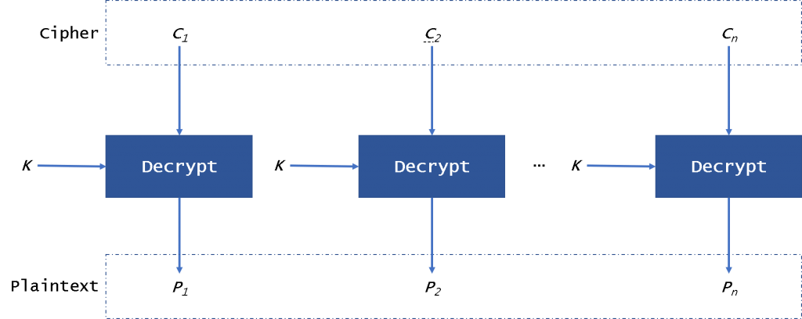
ECB Mode
The ECB (Electronic Code Book) mode is the simplest of all. Due to obvious weaknesses, it is generally not recommended. A block scheme of this mode is presented

Slide 2
We can see it in Figure the plaintext is divided into blocks as the length of the block of AES, 128.
ECB mode needs to pad data until it is same as the length of the block. Then every block will be encrypted with the same key and same algorithm.
If we encrypt the same plaintext, we will get the same ciphertext. So there is a high risk in this mode.
The plaintext and ciphertext blocks are a one-to-one correspondence because the encryption/ decryption is independent, so we can encrypt/decrypt the data in parallel. If a block of plaintext or ciphertext is broken, it won’t affect other blocks.
We can use ECB to encrypt the tables, indexes, wal, temp files, and system catalogs, but with the issues of security, it is not recommended to use this mode.

Slide 3
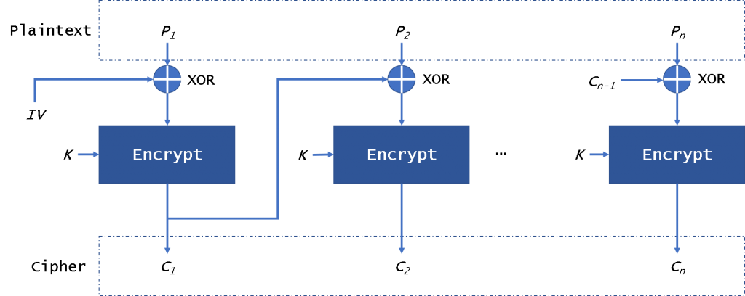
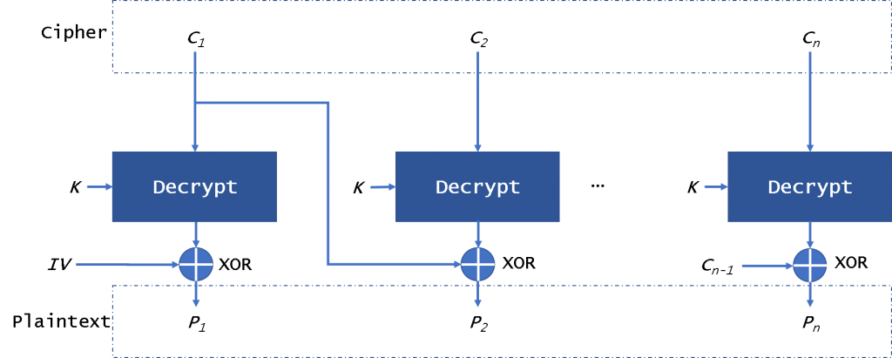
CBC mode
The CBC (Cipher Block Chaining) mode (Fig. 2) provides this by using an initialization vector – IV. The IV has the same size as the block that is encrypted. In general, the IV usually is a random number, not a nonce.

Slide 4
We can see it in figure 2, the plaintext is divided into blocks and needs to add padding data. First, we will use the plaintext block xor with the IV.
Then CBC will encrypt the result to the ciphertext block. In the next block, we will use the encryption result to xor with plaintext block until the last block. In this mode, even if we encrypt the same plaintext block, we will get a different ciphertext block. We can decrypt the data in parallel, but it is not possible when encrypting data.
If a plaintext or ciphertext block is broken, it will affect all following block.

